Slide 1


By: Ospan Ramazan, Saparbek Ulpan, Abdigali Nurasyl
JSE
Job Search Engine

Slide 2
JSE
Job Search Engine
By: Ospan Ramazan, Saparbek Ulpan, Abdigali Nurasyl
Brief overview of JSE
Key Objectives
Provide comprehensive tools for both
job seekers and employers
Simplify job search and recruitment
processes

Slide 3

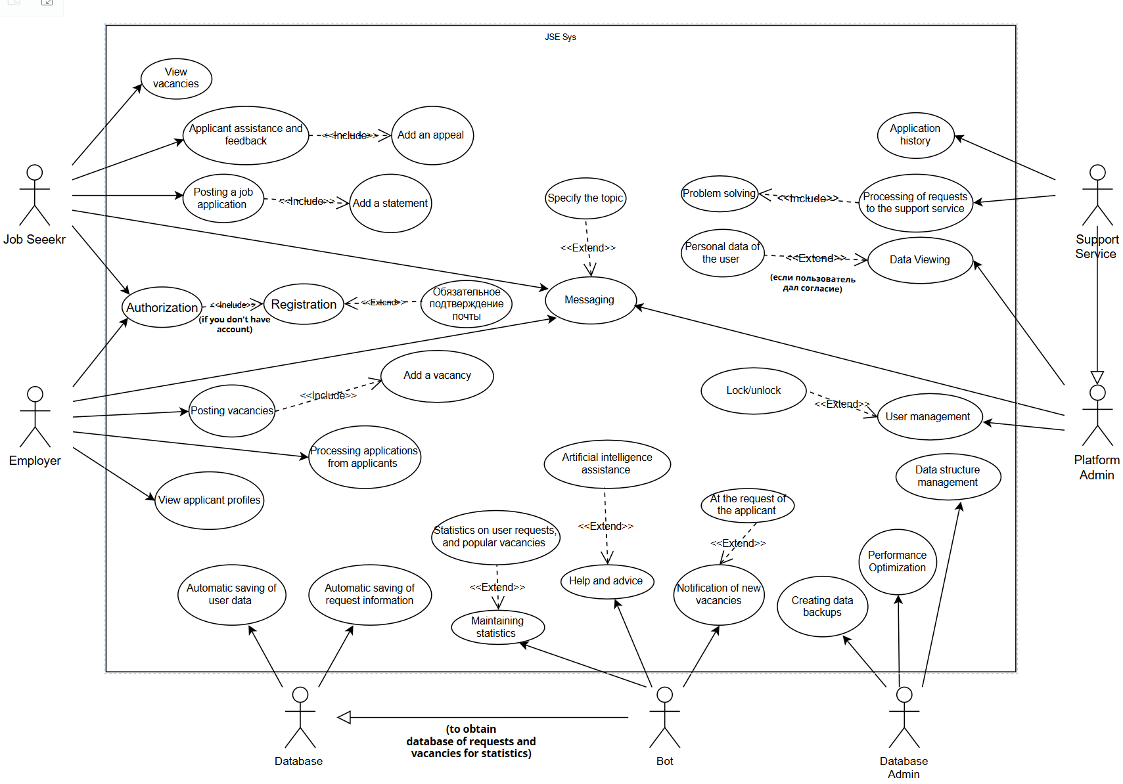

JSE
Job Search Engine
By: Ospan Ramazan, Saparbek Ulpan, Abdigali Nurasyl
Brief overview of JSE
Key Objectives
Provide comprehensive tools for both
job seekers and employers
Simplify job search and recruitment
processes
Use Case Diagram

Slide 4
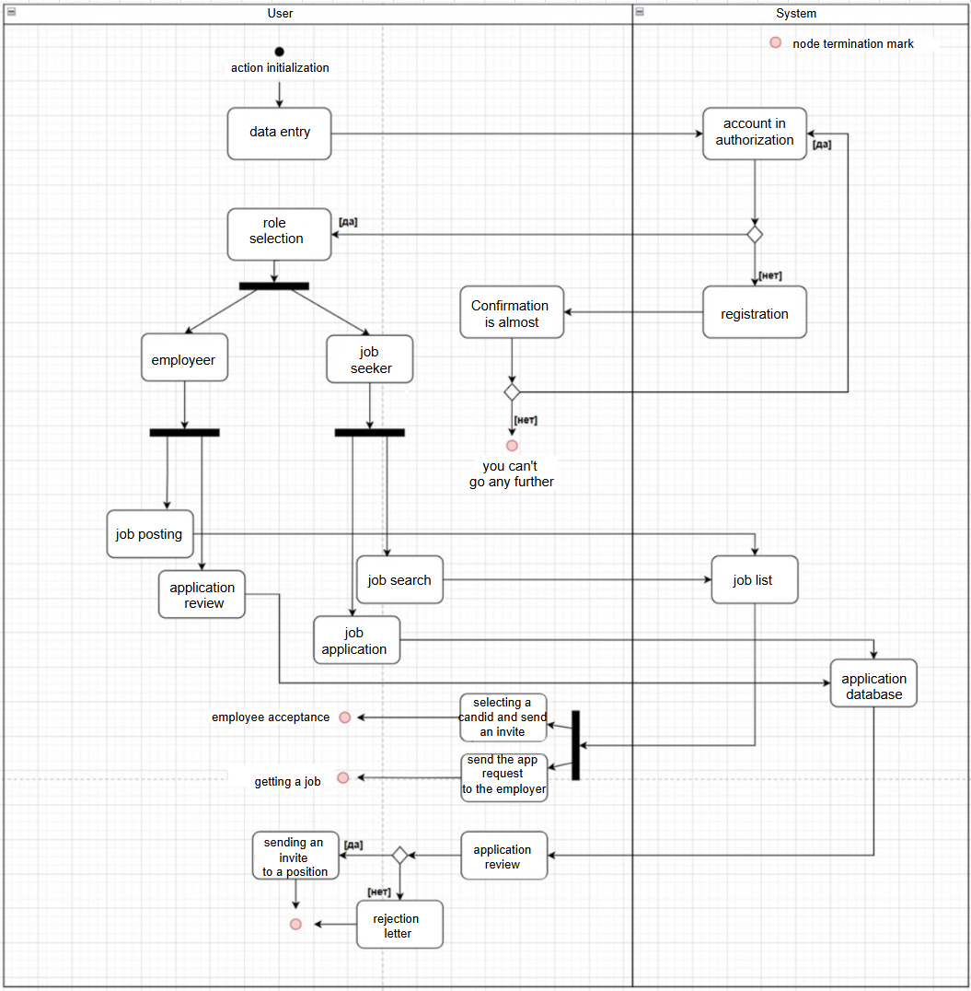
Brief overview of JSE
Key Objectives
Provide comprehensive tools for both
job seekers and employers
Simplify job search and recruitment
processes
Use Case Diagram
Activity Diagram

Slide 5
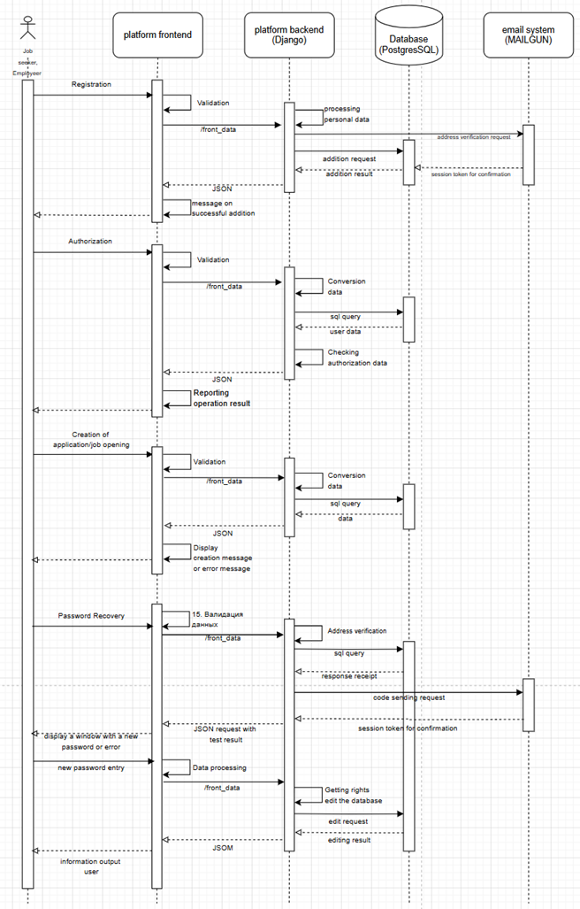
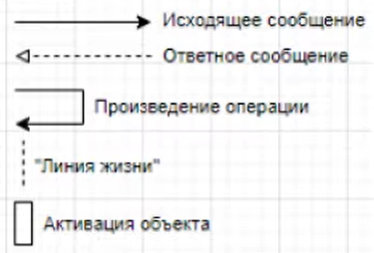
Sequence
Diagram
Use Case Diagram
Activity Diagram

Slide 6
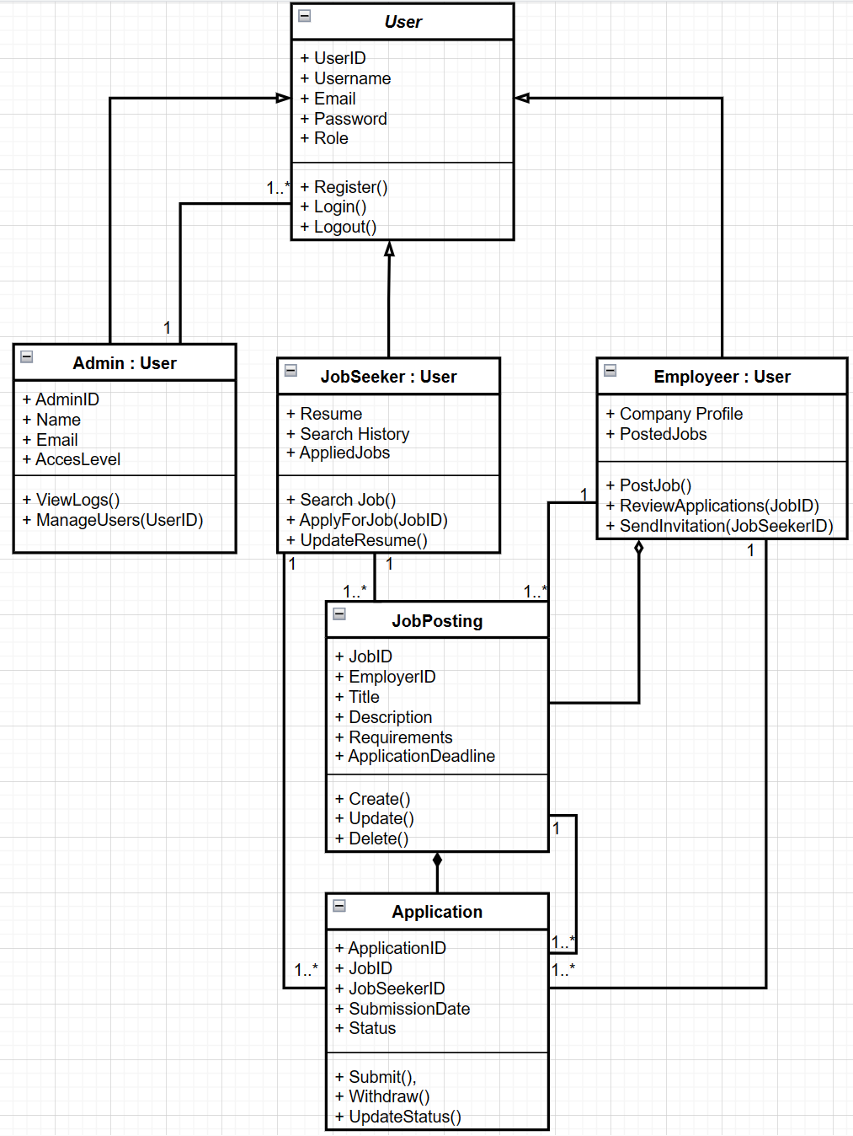
Sequence
Diagram
Class Diagram
Activity Diagram

Slide 7
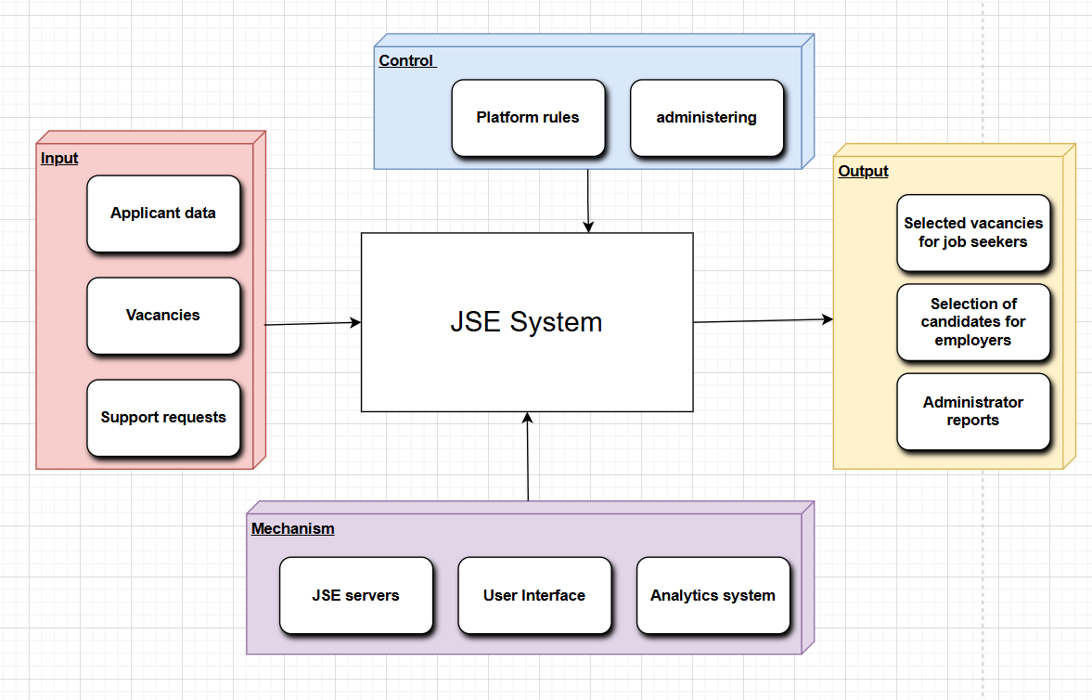
Sequence
Diagram
Class Diagram
Context Diagram
Activity Diagram
Class Diagram

Slide 8
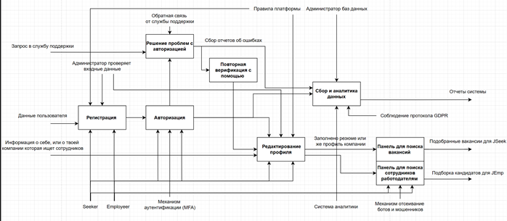
Class Diagram
Context Diagram
Decomposition Diagram

Slide 9
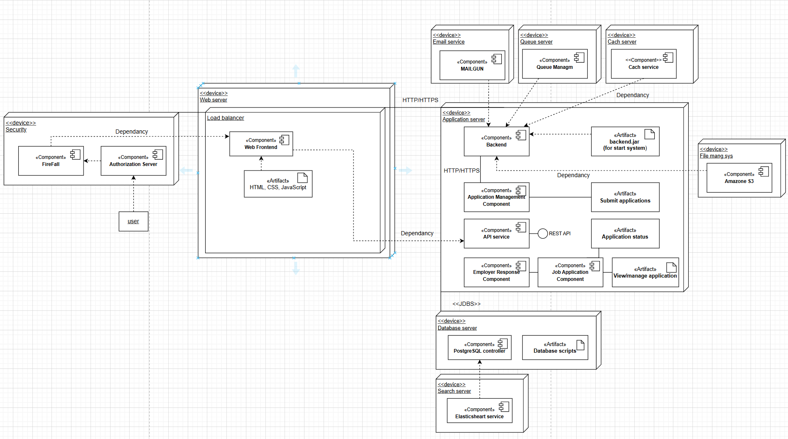
Context Diagram
Deployment Diagram
Decomposition Diagram

Slide 10

Context Diagram
Thank
You
Deployment Diagram
Decomposition Diagram

Slide 11
Context Diagram
Thank
You
Deployment Diagram
Decomposition Diagram

